Slide 1

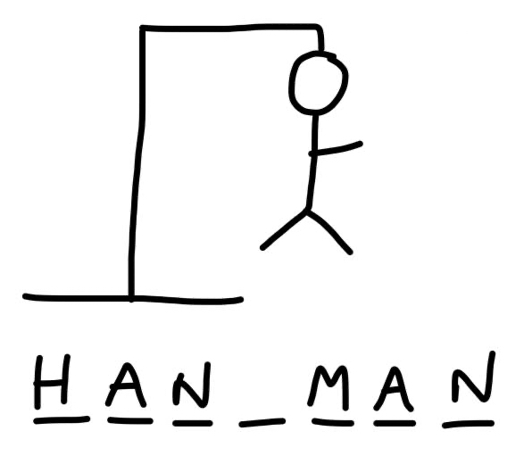
Project 1 - Game Hang Man
Ferdinand Leube – Edgar Tomé

Slide 2
Project 1 - Game Hang Man
Descripton of the Game
Hangman is a guessing game for two players. One player thinks of a word and the other tries to guess it by suggesting letters within a certain number of guesses.

Slide 3
Project 1 - Game Hang Man
Challenges
Setup repository
Plan the project – Jira
Flowchart of the alghoritm
Code alghoritm
Test alghoritm to work acording to the game
Incorporate visulizations

Slide 4
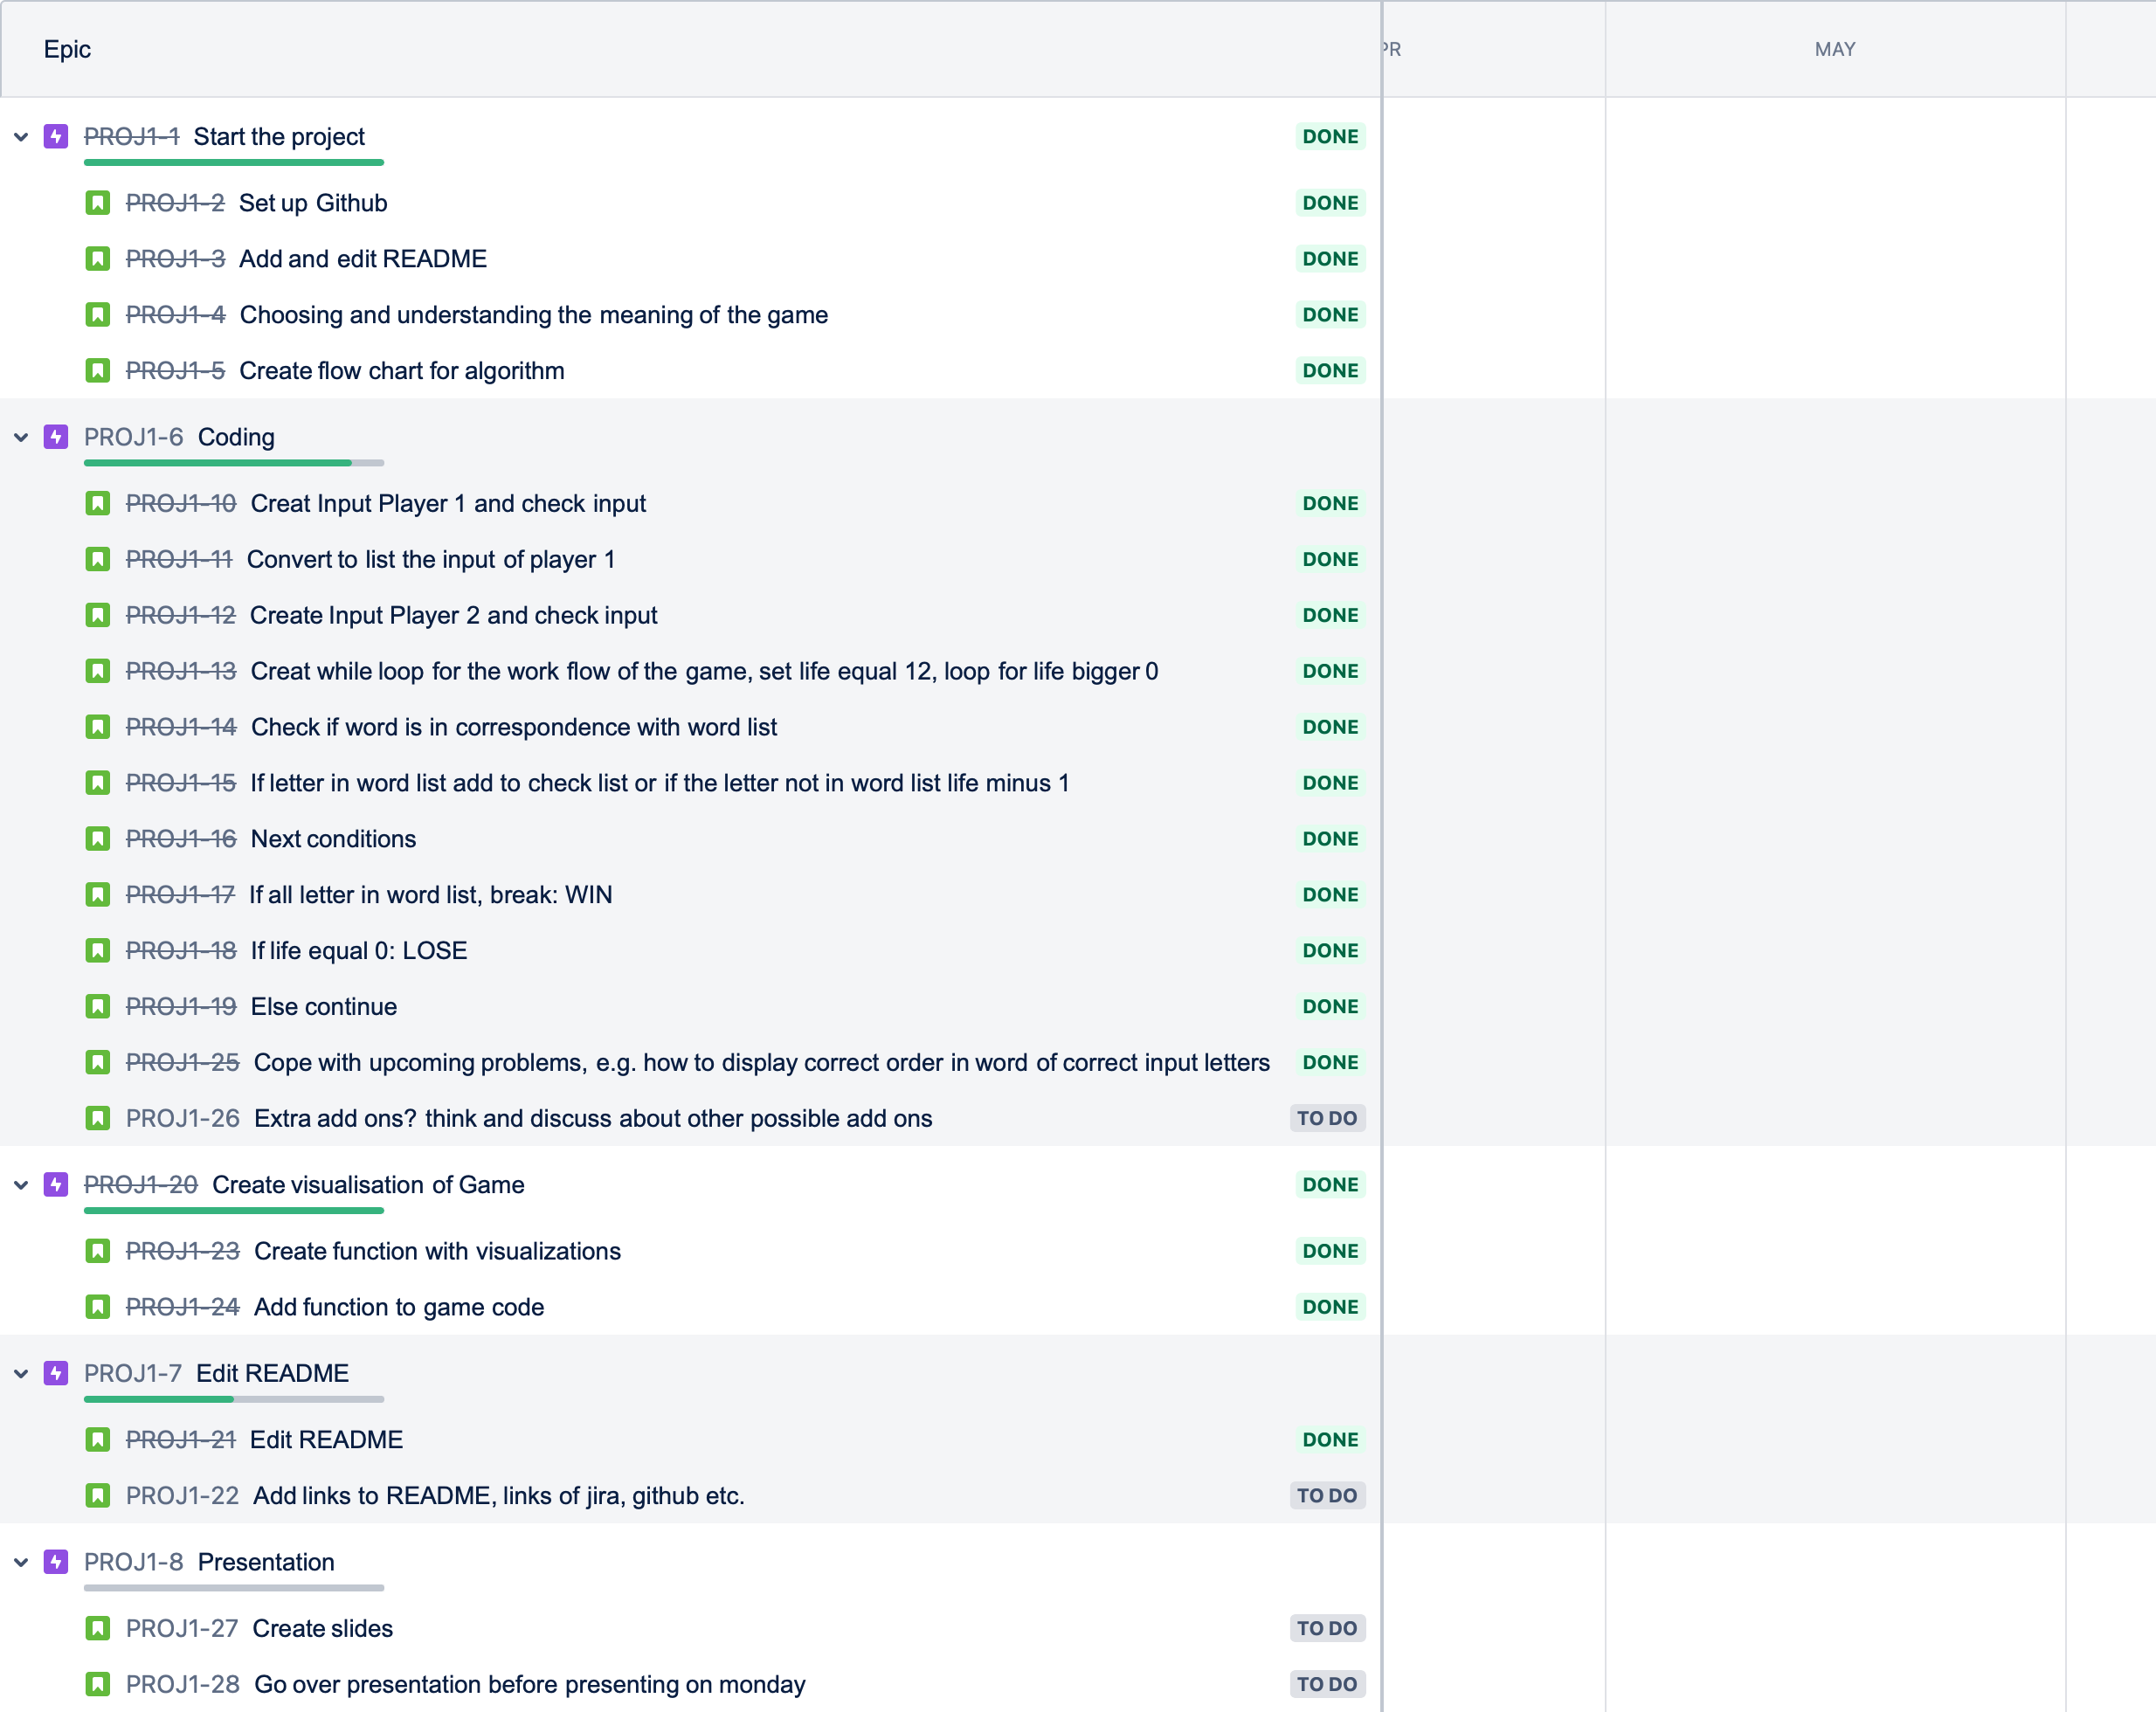
Project 1 - Game Hang Man
Process - Project

Slide 5
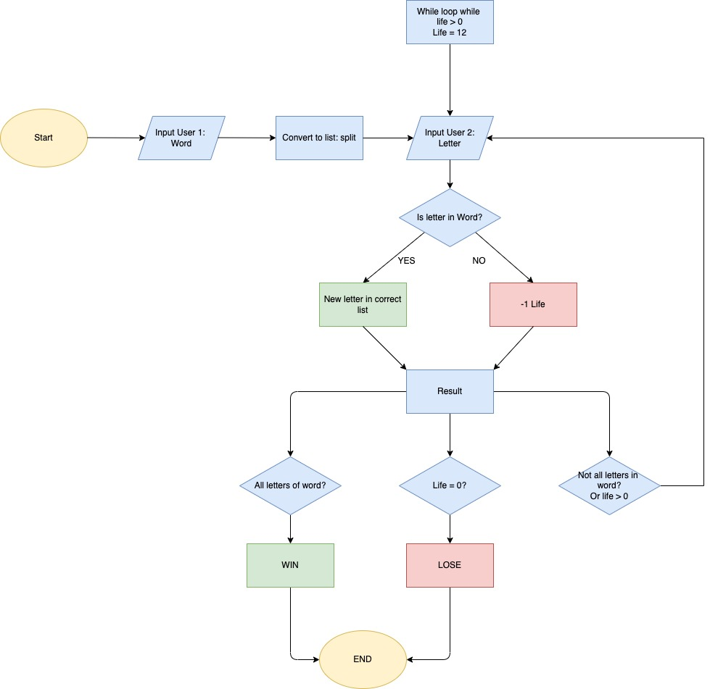
Project 1 - Game Hang Man
Process – Alghoritm

Slide 6
Project 1 - Game Hang Man
Highlights - Code
Player 1 inputs a word the other player has to guess.
Player 2 inputs a letter.
If this letter is a letter of the inputted word, the letter will be presented in the correct position inside the word.
If the letter is not a letter of the inputted word, Player 2 loses 1 life: The new number of life will be displayed as well as graphic picturing the amount of lives lost.
If letter has already been mentioned, Player 2 will be informed about that.
Step 2 - 5 will be repeated until either the word has been guessed (Player 2 wins) or all of the lives have been
Challenges of the code
Place the letter inputed of player 2 in the same order of the word inputed of player 1
Consider the letter inputed of player 2 the number of times is repetead on the word inputed of player 1

Slide 7
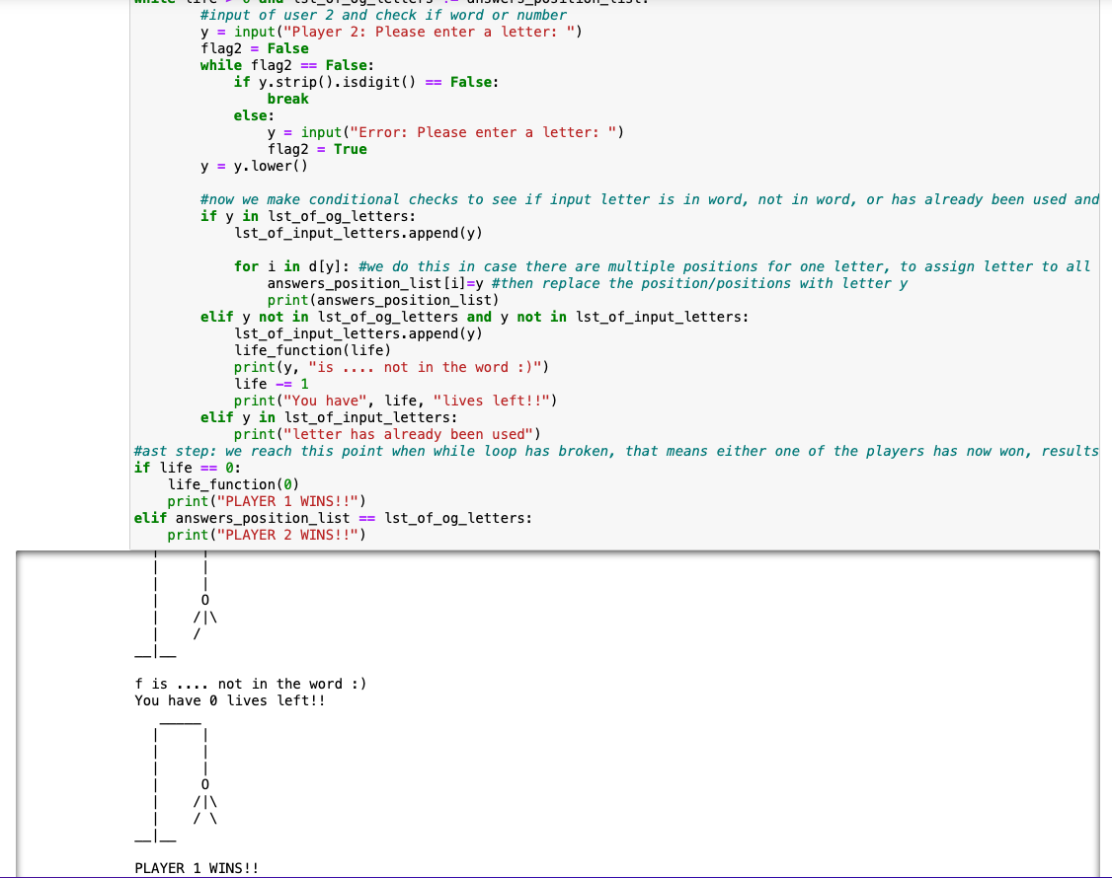
Project 1 - Game Hang Man
Demo

Slide 8
Project 1 - Game Hang Man
Demo
Lets try the game

Slide 9
Project 1 - Game Hang Man
Questions
Q & A
TIME

Slide 10
Project 1 - Game Hang Man
End
Thanks

